Slide 1
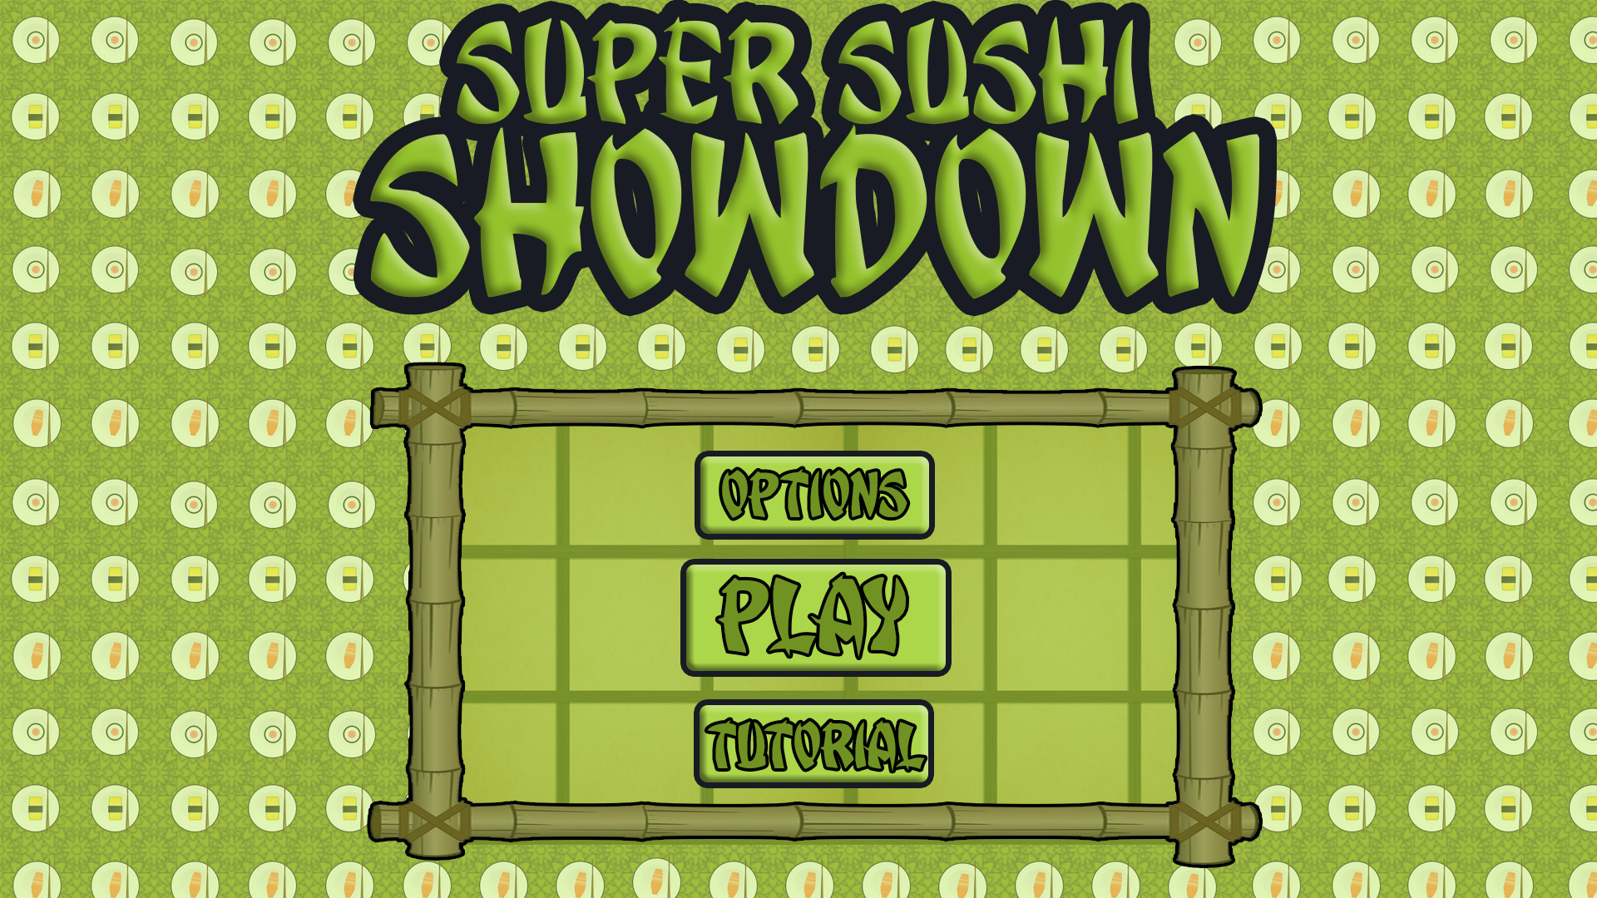
Level 4/5 – Group 5
Bandi Namco Fourth Pitch
Henry Crofts, Ashley Long, Samuel McMillan and Dawid Hojka

Slide 2
Latest version

Slide 3

Changes from player feedback
Did you feel like the game was too slow?
“The speed the sushi moves at is quite slow”
Increase the speed of sushi
“The sushi was hard to tap, kept missing”
Increased the size of sushi colliders
Adjusted the raycast layer

Slide 4
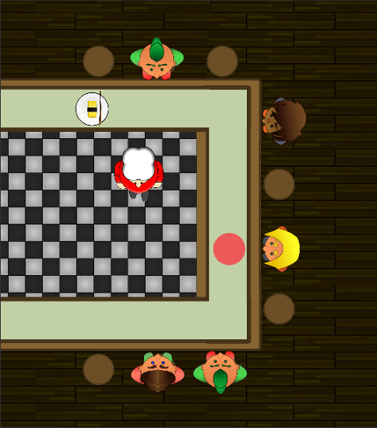
Changes from player feedback
Did the game become more challenging?
How are you keeping the game fair?
Variable speed change

Slide 5




What are players struggling with
Did you understand who was winning and losing throughout the whole game?
Who is winning?
Use customers to display score

Slide 6




What do players enjoy
“I’m not really sure if I’m hitting the node correctly”
Added animated chefs pop ups

Slide 7
Playtesting video

Slide 8
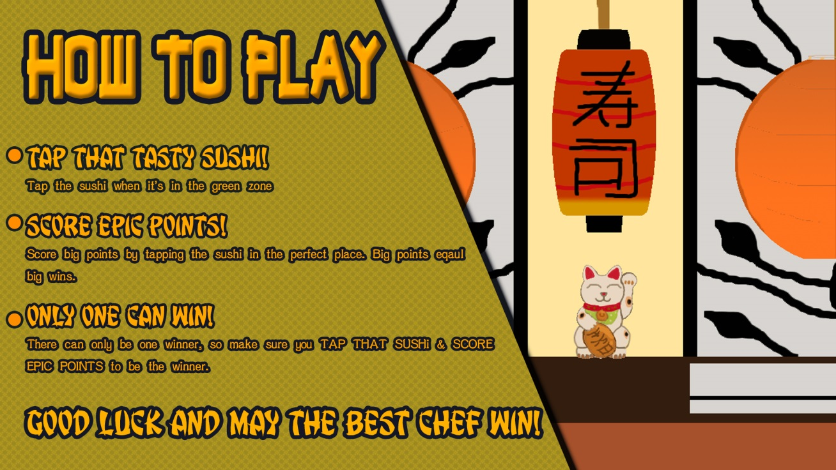
Design lessons learnt
Fix bugs
First player disadvantage
Speed does not always change
Update chef movement
Fix customer movement
Update Art
Sushi bars new colours
Update new chef designs
Update information screen

Slide 9
Programming lessons learnt

Slide 10
Management lessons learnt

Slide 11
Questions?

